Slide 1
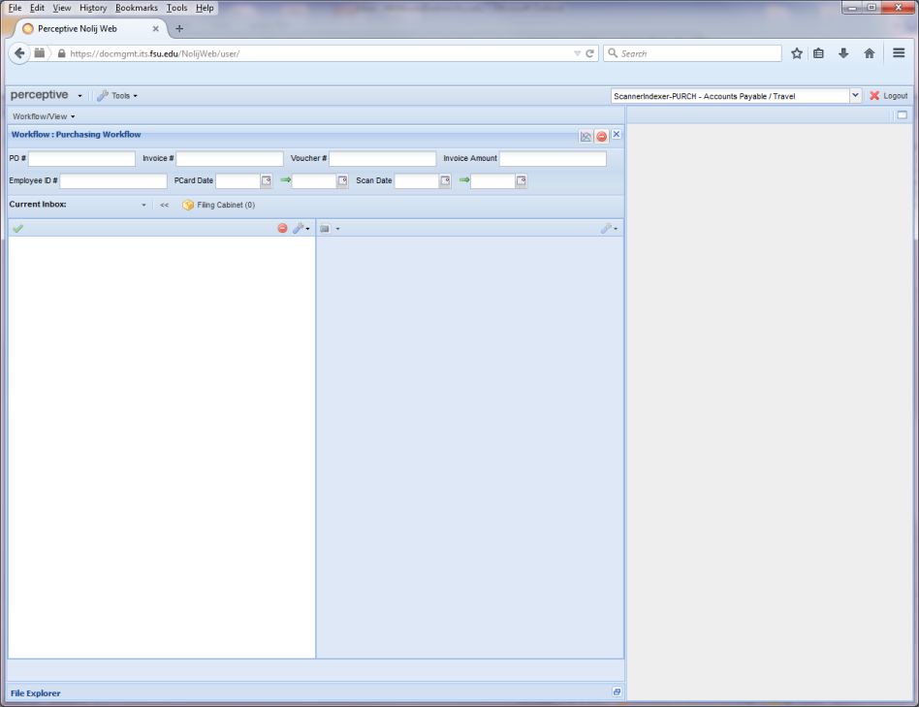
Searching for P-Card Reconciliations in Document Management
To search for a reconciliation in OMNI Document Management, have the Cardholders’ Employee IDs handy.
Open a browser and go to: https://docmgmt.its.fsu.edu/NolijWeb/user/
Enter UserName and password
Document Management page will open.
If the role displayed is not “FI_Everyone – Accounts Payable/Travel”, click the drop down menu and select that role.
Notes:
Introduce trainer

Slide 2
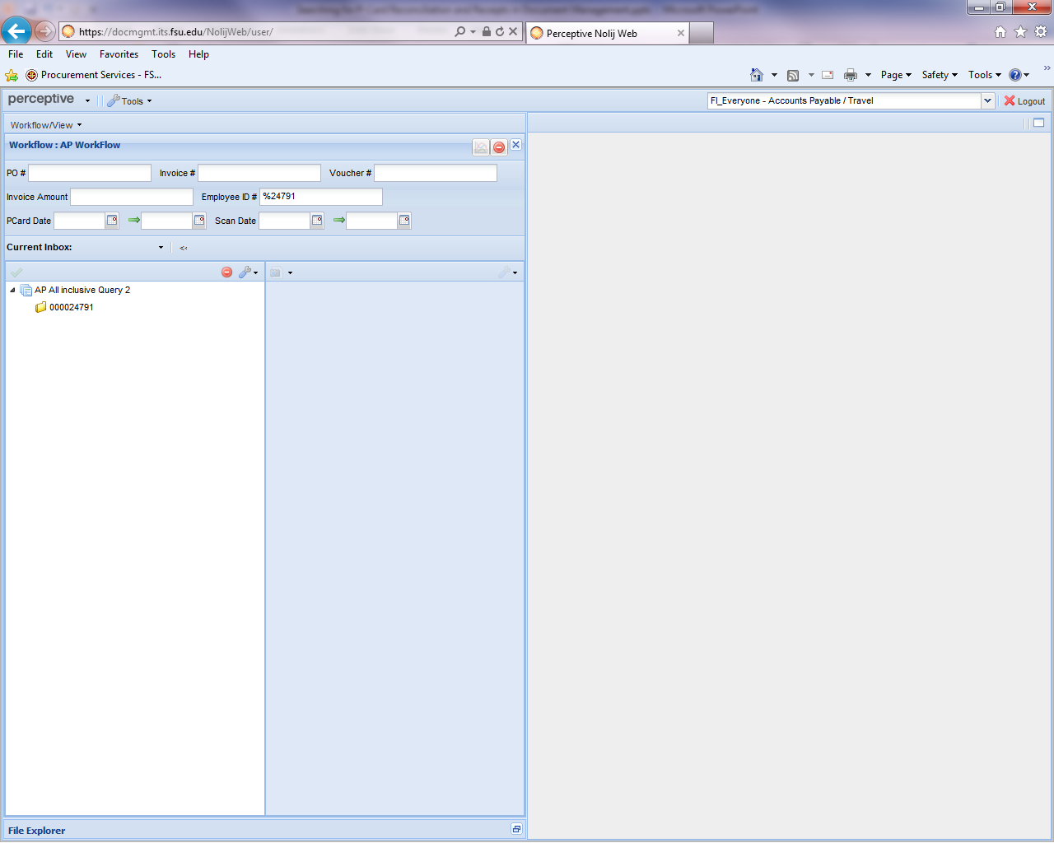
Searching for P-Card Reconciliations in Document Management
Enter % and the last five digits of the Employee ID in the appropriate field.
Hit enter.
Click Employee ID in bottom box to see list.
A date range can be entered to further limit the search.
For this example, just the Employee ID was used.

Slide 3
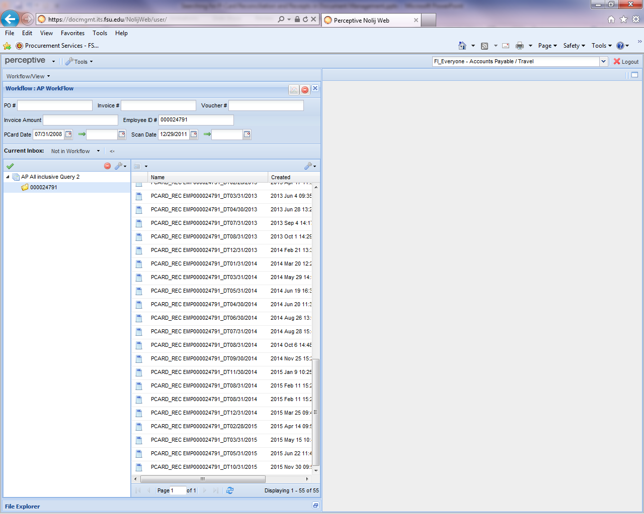
Searching for P-Card Reconciliations in Document Management
Scroll down the list and select the reconciliation file needed.

Slide 4
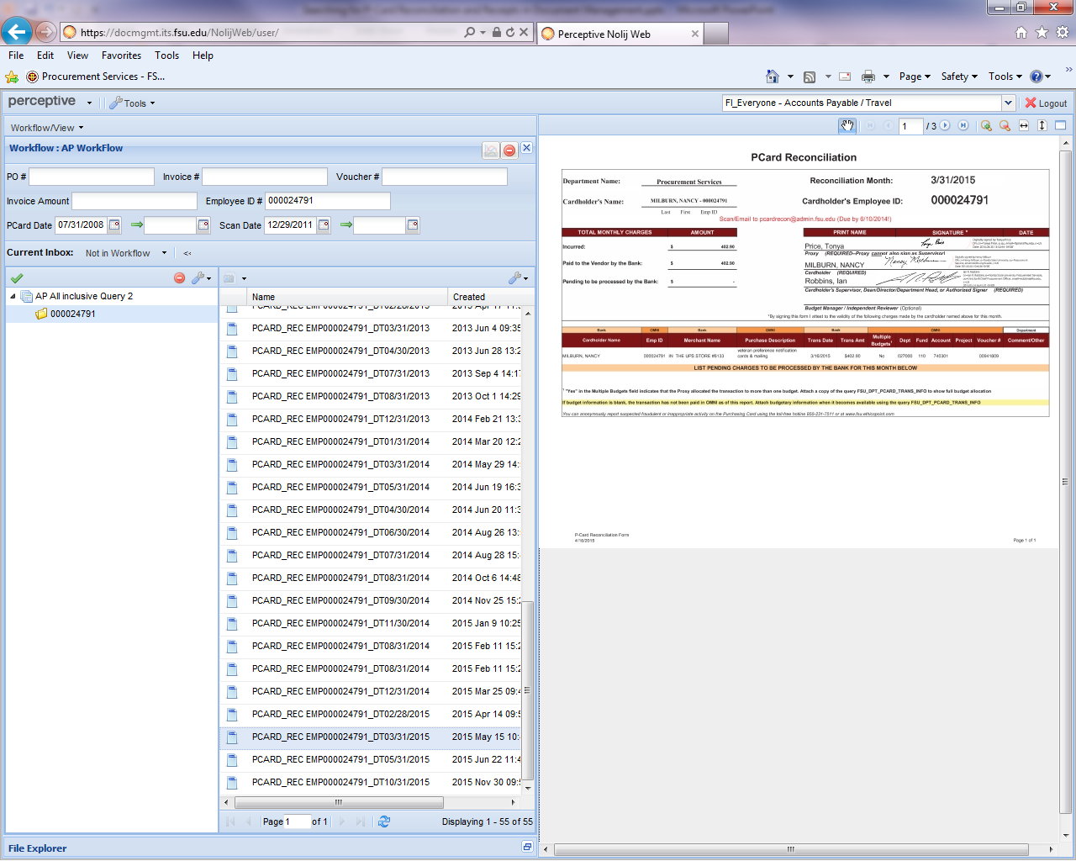
Searching for P-Card Reconciliations in Document Management
Once selected, the reconciliation sheet will come up.
You can adjust column sizes to make viewing the list or documents easier to read.
Receipts are in the subsequent pages.

Slide 5
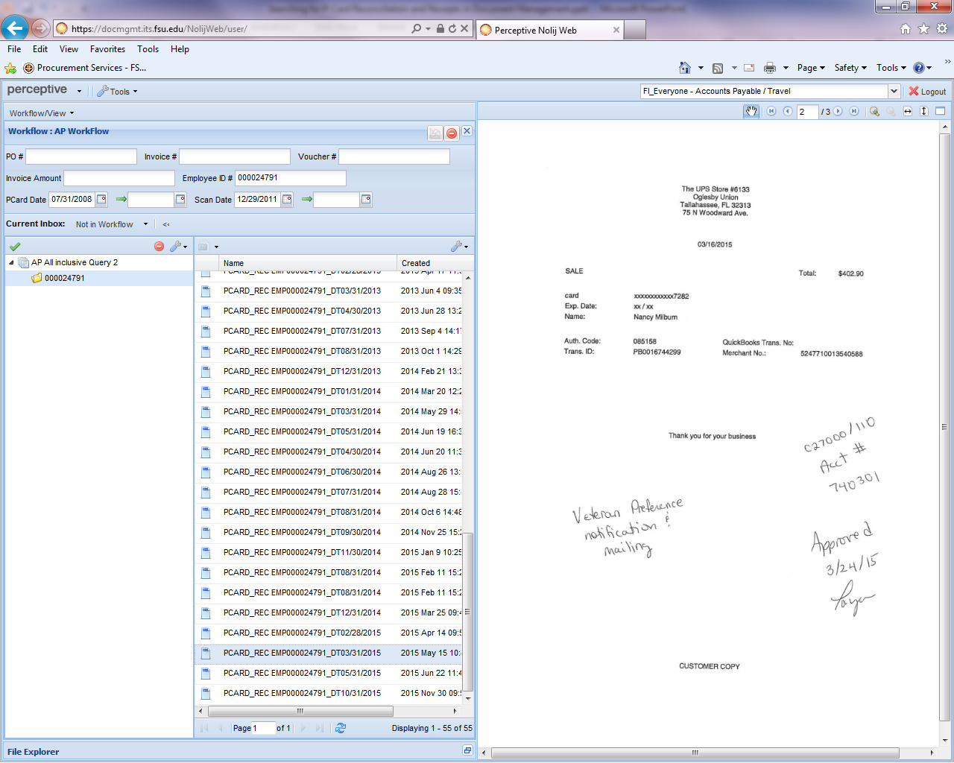
Searching for P-Card Reconciliations in Document Management
Click the arrow to scroll through the receipts to find the one needed.

Slide 6
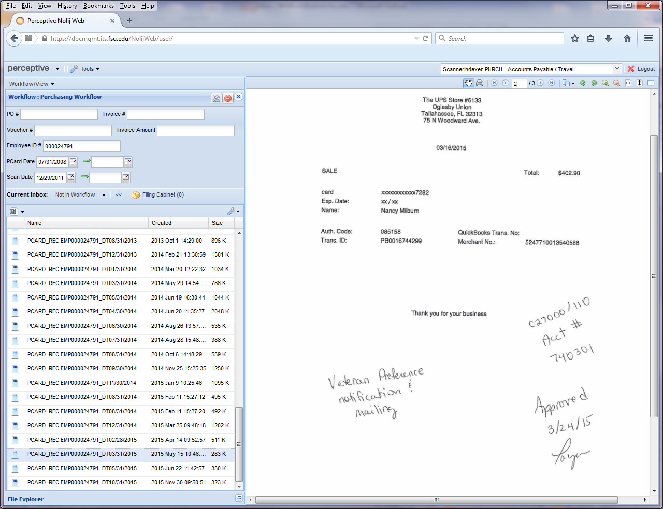
Searching for P-Card Reconciliations in Document Management
If you want to print a document, double click the file name so the documents open in a new window.

Slide 7
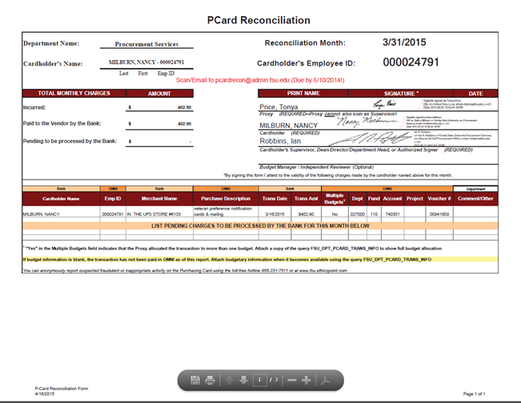
Searching for P-Card Reconciliations in Document Management
Once opened, use the arrows to find the document to print or save, then click the printer icon to print that document.

Slide 8
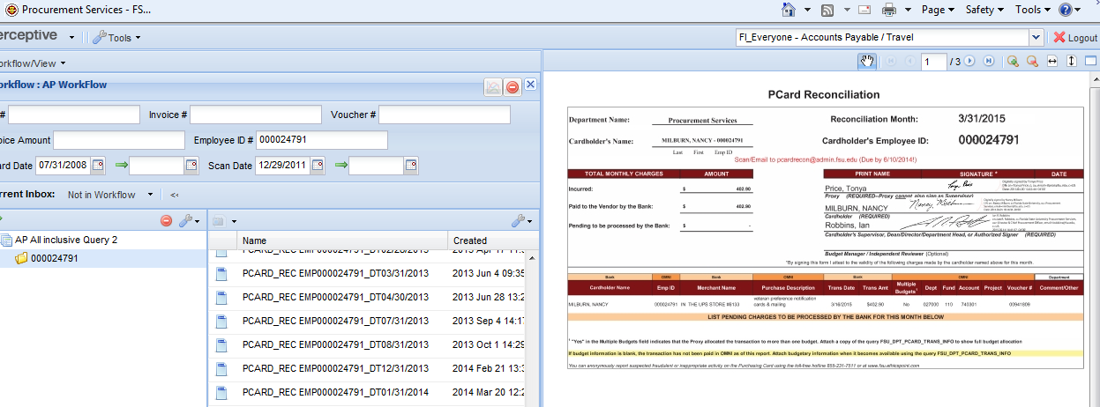
Searching for P-Card Reconciliations in Document Management
To exit, just click the
link on the main Document Management page.

